Slide 1
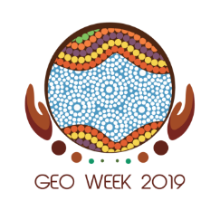
Earth Observations: Investing in the Digital Economy – Investing in our Shared Future
Dr. Kitutu Kimono Mary Goretti,
Minister of State for Environment, Uganda
GEO Week 2019 Ministerial Summit Canberra, Australia 8th November 2019

Slide 2
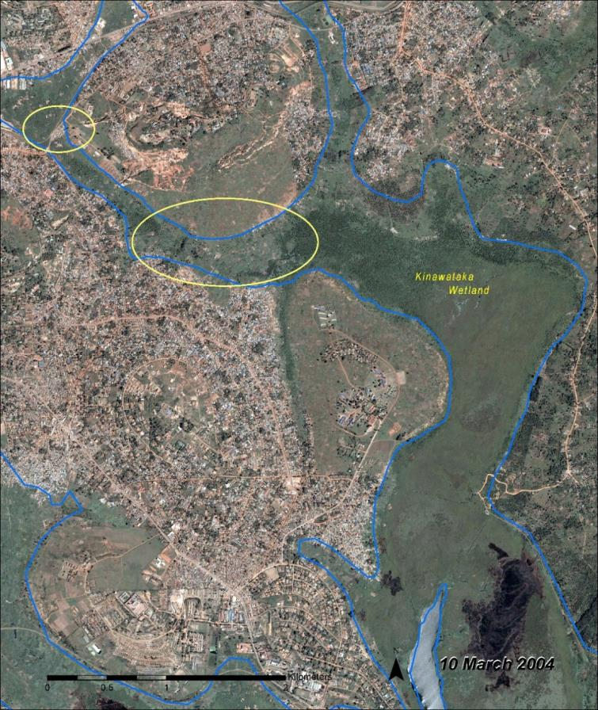
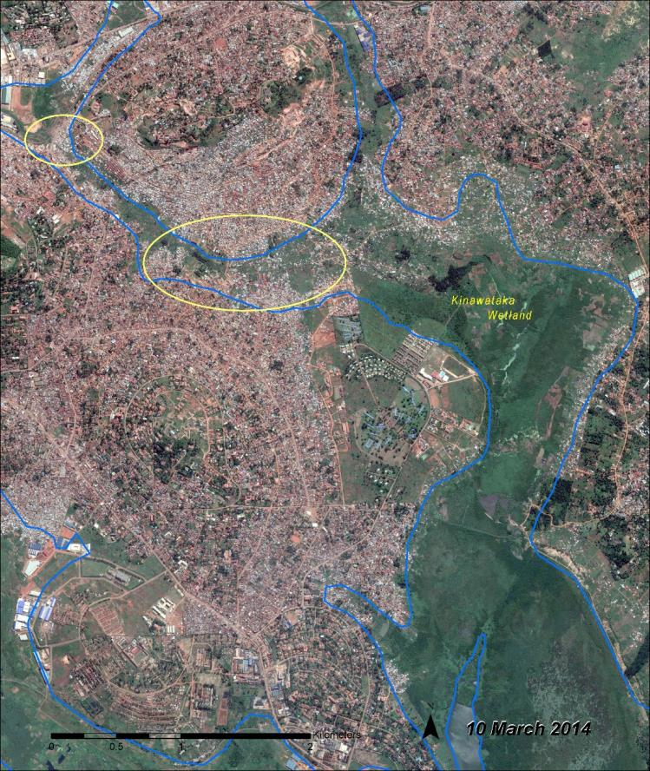
Earth Observations in Uganda
Notes:
Last month I met with the President of Uganda, H.E. Yoweri Museveni, to advise on land conflict issues we were facing in the Northern part of our country.
Using time series images and open Earth observation data on Uganda’s Zoka Forests, we had correct and detailed information that we needed to review the land claims being made and to assess encroachment on Uganda’s protected areas.
This very recent example highlights the value of Earth observations to the Ugandan Ministry on Environment, and it provides a starting point for my key note address on the need for Investments in Open and shared earth observation data.
I hope to show the usefulness of Earth observation data to other Ministries and not just from Uganda’s perspective, but to highlight the global value that this information holds for those in disaster reduction, food security and to address our changing climate.
But first, a short history lesson will help set the scene of where we are today with Earth observation technologies and how far we have come.

Slide 3
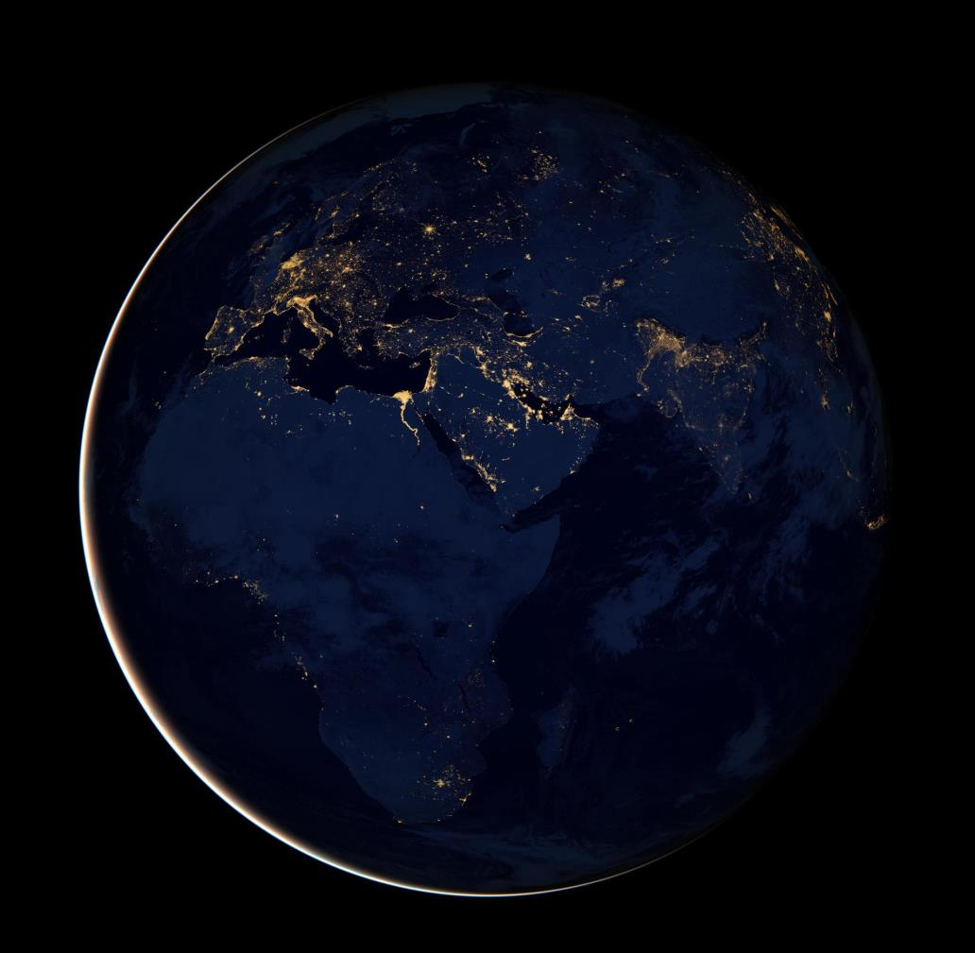
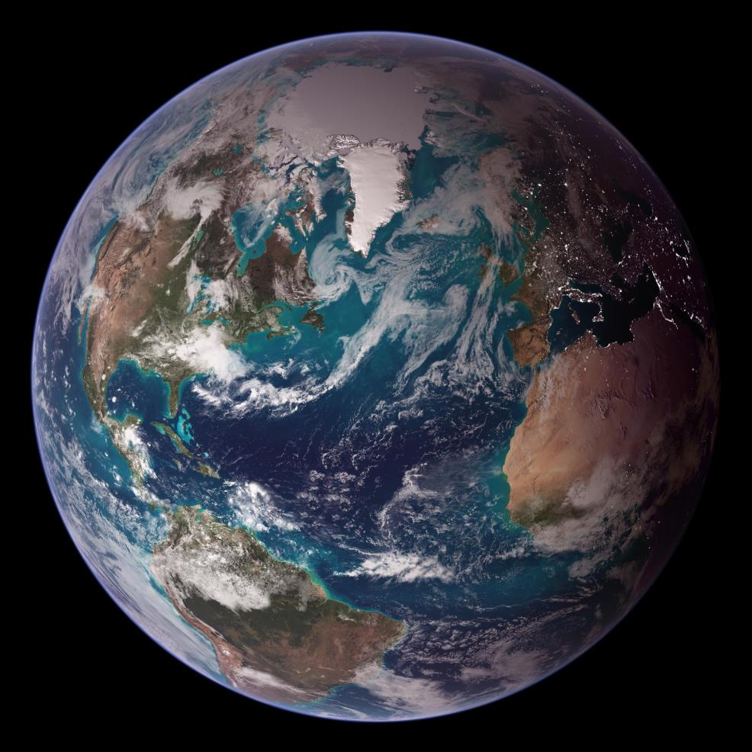
Global perspective on Earth observations
Credit: NASA
Notes:
Earth observations literally change the way we see ourselves, and our planet.
For the past 50 years the science of earth observations has grown from small cameras to sophisticated satellite systems that orbit the universe collecting useful information for use in various fields. For more than four decades, the National Aeronautics and Space Administration’s (NASA) Landsat and, since 2014, the European Space Agency’s (ESA) Sentinel satellites have captured images of Earth and helped humanity gain perspective on our planet and ourselves.
But not long ago, to see and use these images, you had to fax NASA and wire them the payment before a staff member would search for the image you requested and fax it back to you. Today, these images are digitally stored and publicly and freely available.
Satellite imagery essentially shows us in real-time how the natural environment around us is changing. And with new and better satellites, the level of detail and frequency is increasing rapidly. This information is helping policy-makers, corporate leaders, land owners and communities make better decisions about how to steward and manage the land and water resources around them.
Seeing things from a distance can help us gain new perspectives and space provides a unique viewpoint for understanding our living planet and how we see our shared world.

Slide 4
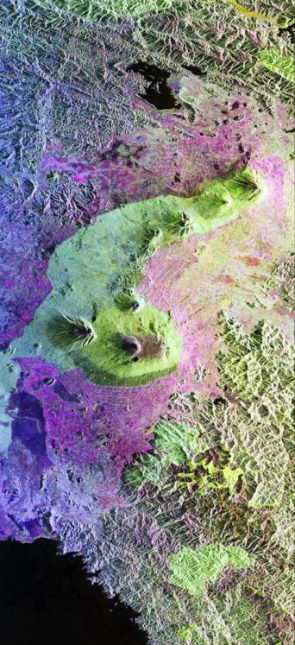
An investment that offers shared benefits
Investing in Earth observations provides benefits to: environment and resources management, biodiversity, agriculture and food security, transport, weather, air quality and health, disaster risk management, security and more…
False colour image of gorilla habitat in Uganda’s border with Rwanda, Zaire. NASA
Notes:
Countries across the world need to tackle a series of environmental and natural resource challenges — from deforestation and illegal mining to food scarcity
When analyzed appropriately, these images can give us information about land use, water quality, changes in the landscape, coastal erosion, urban development and much more
I would like to briefly explain three cases where open Earth observations have been used effectively in Uganda, as an inspiration as to what can be done when this information is applied correctly.
Firstly, I will give more context to our monitoring of forests and wetlands recovery projects.
Then, I will highlight the use of Earth observations in disasters and how we are managing risk.
Finally, I will present the work of GEO’s Agricultural Monitoring Initiative and how it is helping save lives and emergency response funds.

Slide 5
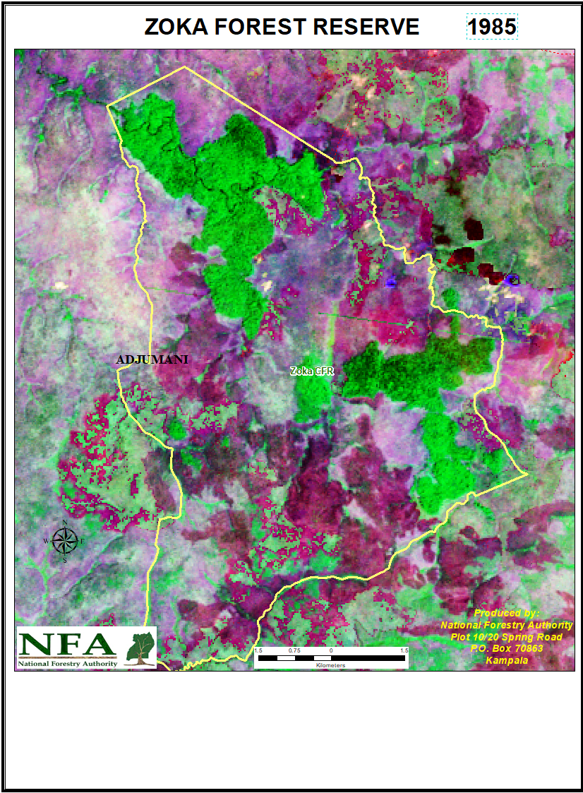
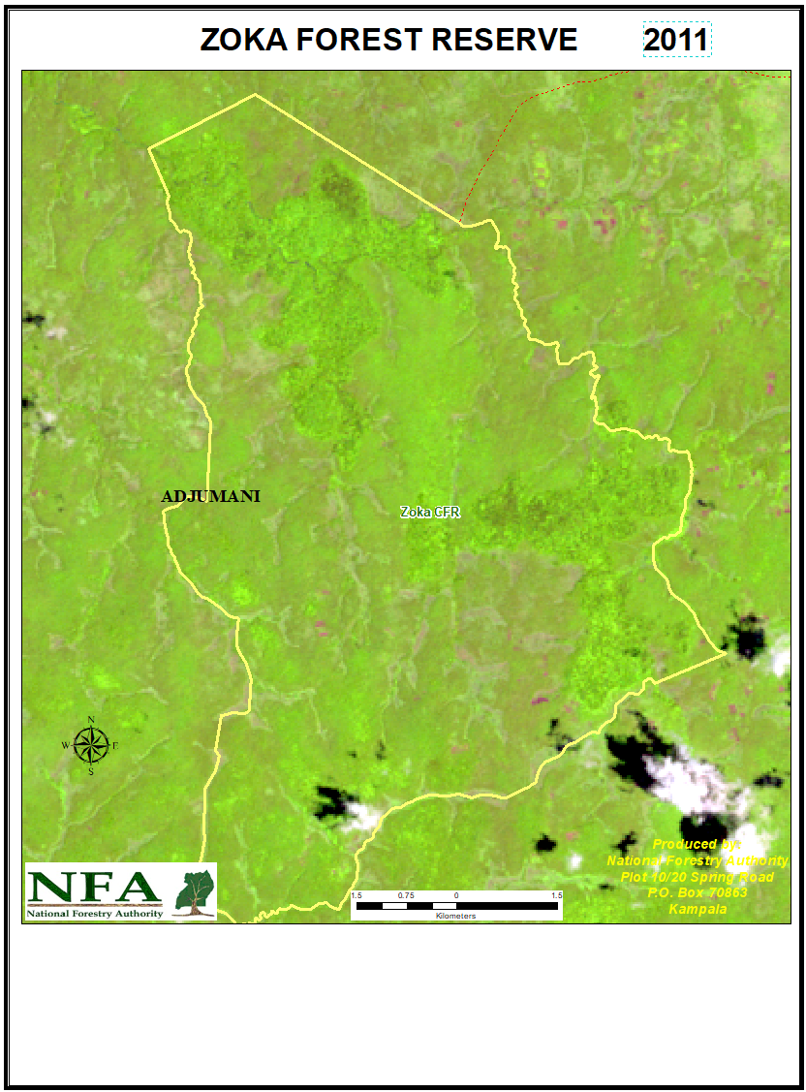
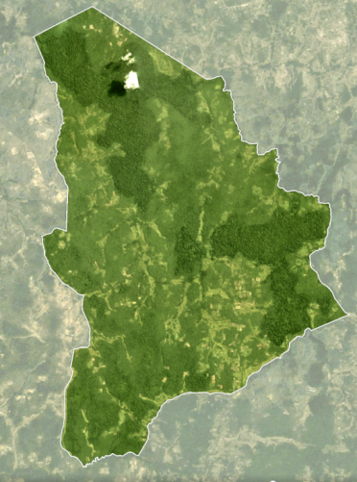
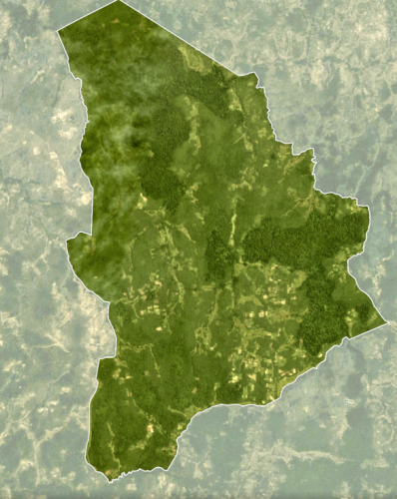
Monitoring encroachment in Zoka forests
Notes:
These images were prepared at the height of the land conflict in Apaa to show that those claiming ancestry in Apaa and Zoka Central Forest Reserve were not telling the truth. They don’t show the whole of Zoka but shows part of it. They however show Apaa which is the source of the problems for Zoka CFR.

Slide 6
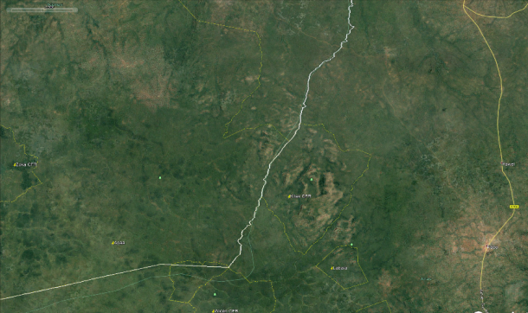
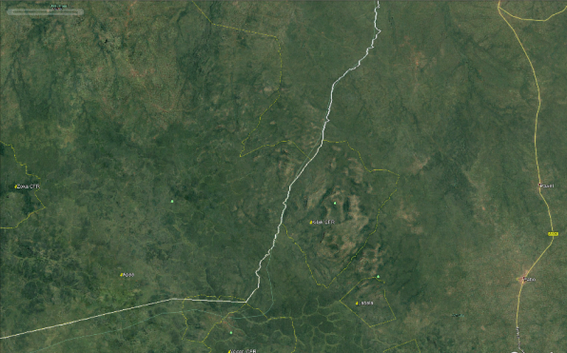
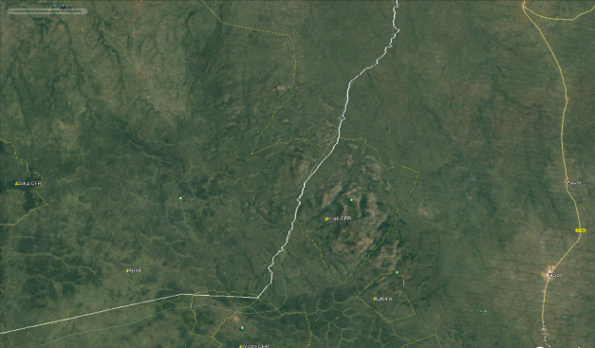
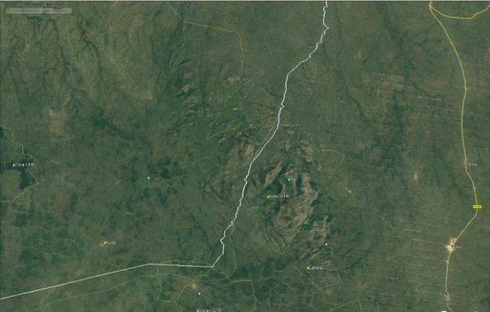
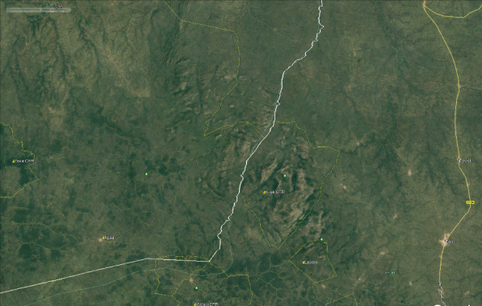
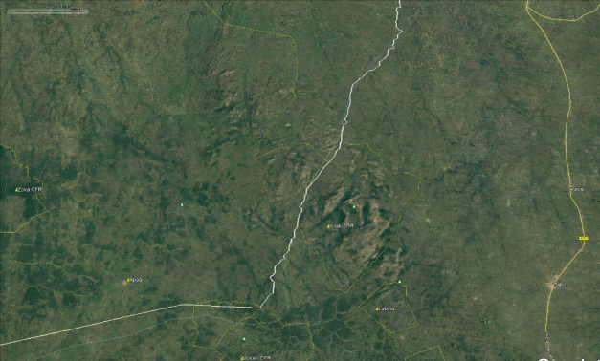
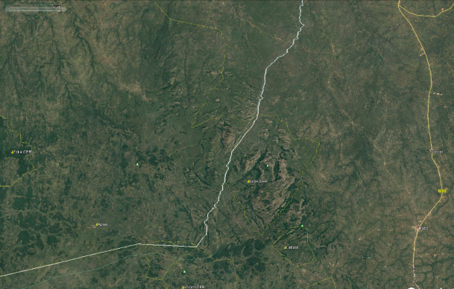
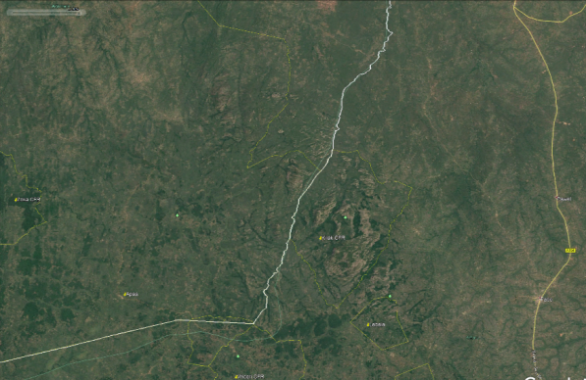
2000
2002
2005
2007
2008
2010
2014
2016
Apaa land conflict in Northern Uganda
Notes:
It was in 2002 that we started seeing human activity somewhere in Wiceri CFR. By 2005 these people were concentrated into an internal displaced people’s camp due to the Konyi war in northern Uganda. Zoka and all of Southern Adjuvant district was pristine. The IDP camp was there even in 2008 but the war had ended. In 2010 we see that the camp had wound up. I suspect people started exploring land across in Adjumani wilderness because we start seeing the birth of Apaa trading centre. By 2014, people had started spreading and creating villages extending to Zoka. Even a road through Apaa had been created.
The information provided by this time series allowed us to counter the claims being made, and to take appropriate action.

Slide 7
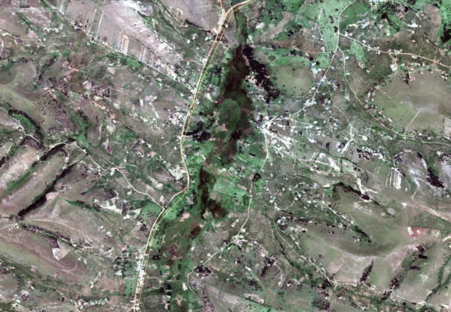
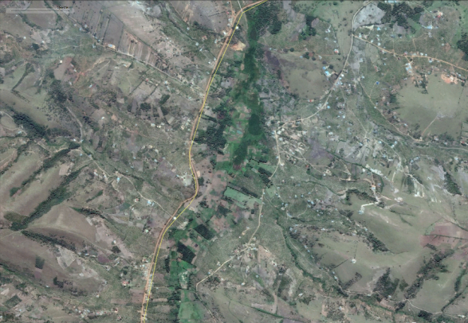
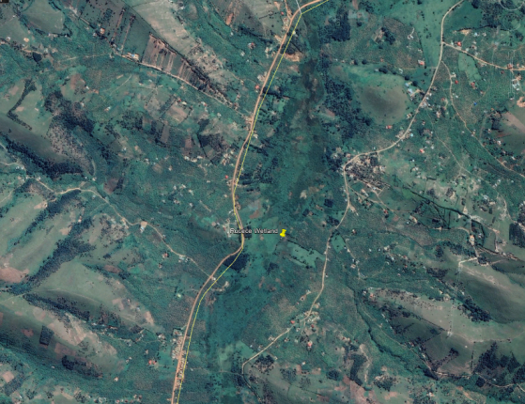
Wetland restoration in River Rwizi catchment Mbarara district
2011
2016
2019

Slide 8
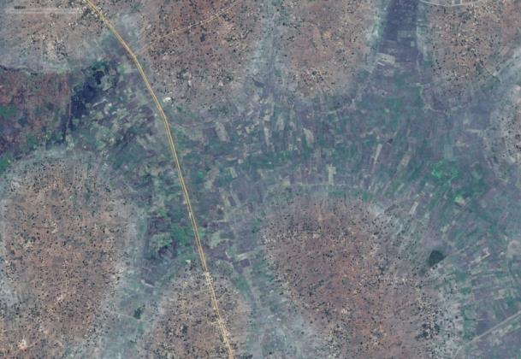
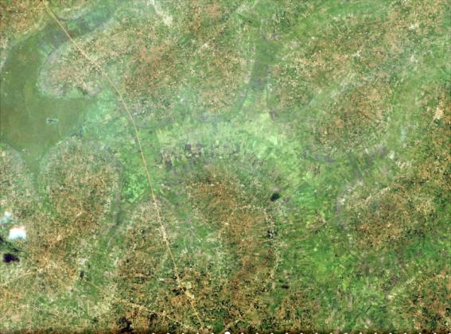
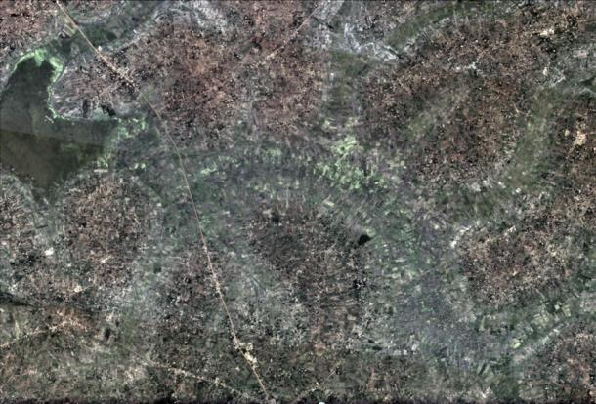
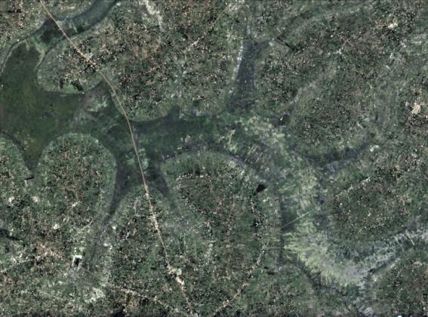
Limoto wetland restoration
2014
2016
2016
2017
2019
2019

Slide 9
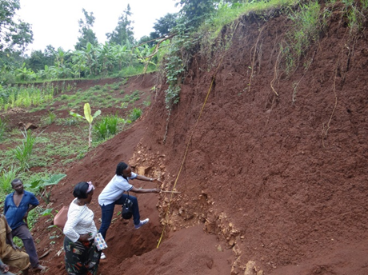
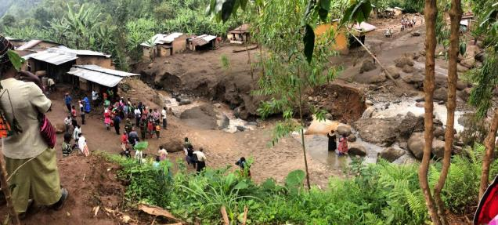
Earth observations for managing disasters and risk
Uganda is susceptible to hydrological, geological, climatic and human-induced disasters
The country experiences drought, flooding, landslides, storm winds, refugee influxes, crop pests and epidemic diseases
Uganda uses Earth Observations (EO) technology in disaster risk monitoring and disaster assessment
National Risk Atlas completed in 2018 for use in long term planning. All districts assessed, risks-profiled, and risk-mapped
Refugee hosting districts given added attention in disaster risk management

Slide 10
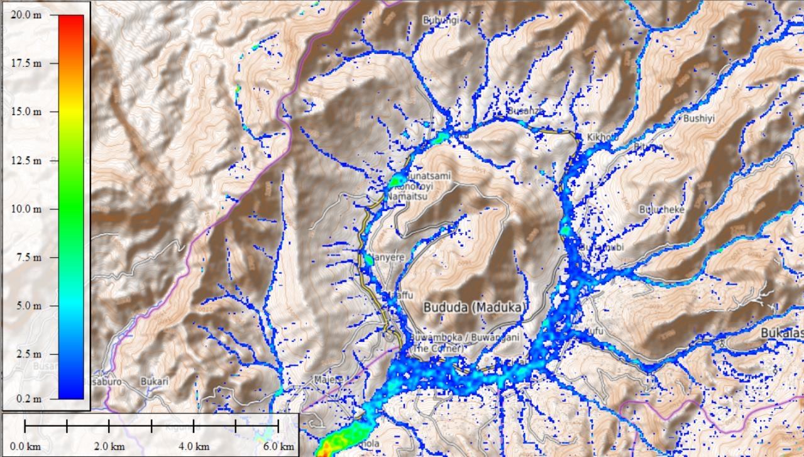
Disaster risk reduction planning
Steep Slopes and Narrow Valleys
Unstable Volcanic Soils
Heavy Rainfall and Fast Moving Channels
Flash Flood Probability Map of Bududa District, Mt. Elgon Region
Notes:
With the implementation of the national policy on disaster preparedness, Management Uganda is working toward managing risk instead of managing disasters

Slide 11
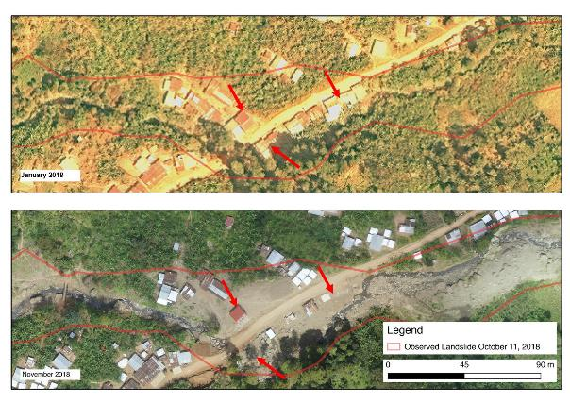
January 2018
Bukalasi Tsuume River bridge, Satellite (Pre) and UAV Imagery (Post), Bududa District, Mt. Elgon Region
Affected Area, Oct 11, 2018

Slide 12
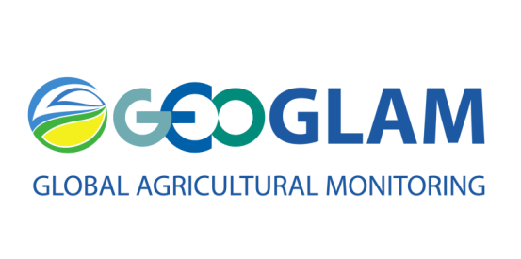
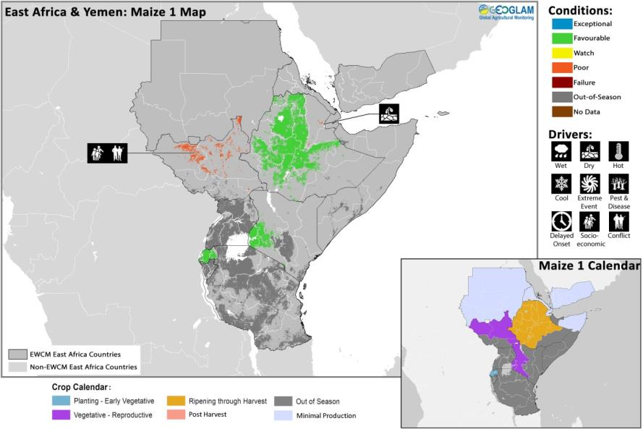
Food security and crop monitoring
Using satellite data obtained from the GEOGLAM System, Earth Observations are helping to monitor crop conditions
Uganda Crop Monitor System is a national adaptation of the GEOGLAM Crop Monitor
Notes:
GEOGLAM is GEO’s flagship initiative that monitors Agricultural conditions and is improving food security in Uganada, and globally.
The GLAM system is our main tool for monitoring and reporting on food security in Karamoja, Uganda.
The data covers the whole region and we can effectively track crop conditions.
This data forms a clear and transparent basis for evaluating crops.

Slide 13
Food security and crop monitoring
Notes:
For example, in 2017 GEOGLAM worked with the Prime Minister’s office to report an impending crop failure.
The result: policy makers could take action with 3 months warnings.
We estimate that over 150,000 people were helped and that we saved 2.6 million USD in emergency response funds.

Slide 14
Food security and crop monitoring
GEOGLAM is monitoring conditions around the world
Investing in shared and open platforms is key
Scaling up the use and applications of this data
Notes:
GEOGLAM is a global initiative that is improving food security around the world.
It shows how investment in shared and open Earth observations can have a global impact.
We have found the same with the Environment Information Network.

Slide 15
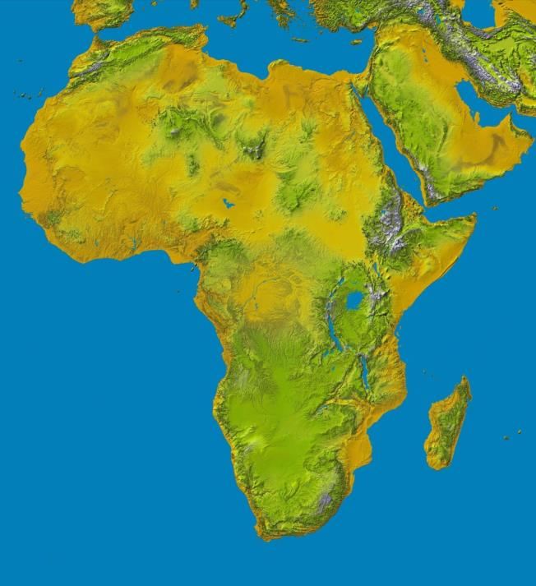
Lessons from the Environment Information Network
Data availability and sharing can be a hurdle to availability of information.
Since 1994 the Government of Uganda through support from UNEP formed an interdepartmental network known as Environment Information Network (EIN) to address these challenges.
This was later scaled up to form the Africa Environment Information Network (AEIN).
Building capacity of other countries such as Ethiopia, Tanzania and Mozambique.
Digital elevation data for Africa. Credit: NASA

Slide 16
Conclusion
Investments in open Earth data provide numerous benefits
Promote the use of space technology and data in decision making
Strengthen existing networks in information gathering and use
Future investments in shared EO will benefit all nations
Thank you!
ASANTE

